Slide 1
SQL

Slide 2
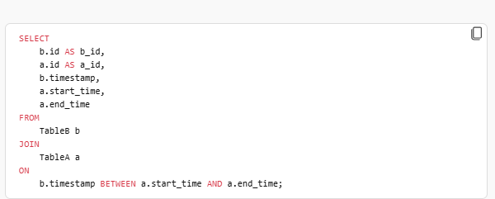
Using interval match to join for values that under range categories
Problem: Got problem to join the values under range categories
Solution: Use interval match or join using between in SQL
Can be used for date also

